Slide 1
Fading channel
Notes:
1

Slide 2
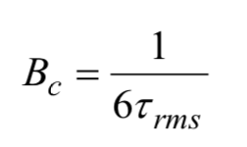
Coherence Bandwidth
Coherence bandwidth: Maximum bandwidth supported without need of equalisation in time dispersive, or frequency selective, channel. The bandwidth over which the frequency response of the channel is flat.
$B_{c}$ based on the correlation of the fading envelope in frequency domain
inversely related to channel’s delay spread

Slide 3
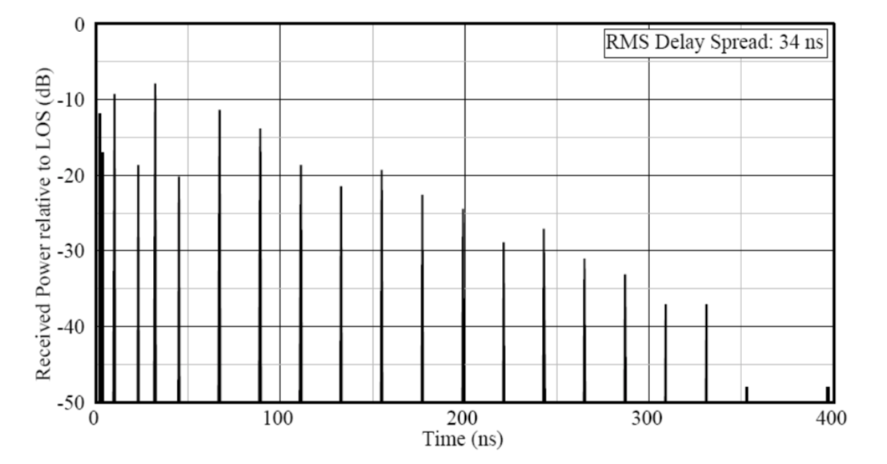
Power Delay Profile
The time dispersive nature of the channel is characterised by the Power Delay Profile (PDP)
Obtained by plotting the power of each multipath against its time of flight
Sometimes, time of flight is normalised relative to the time of the first arriving ray

Slide 4
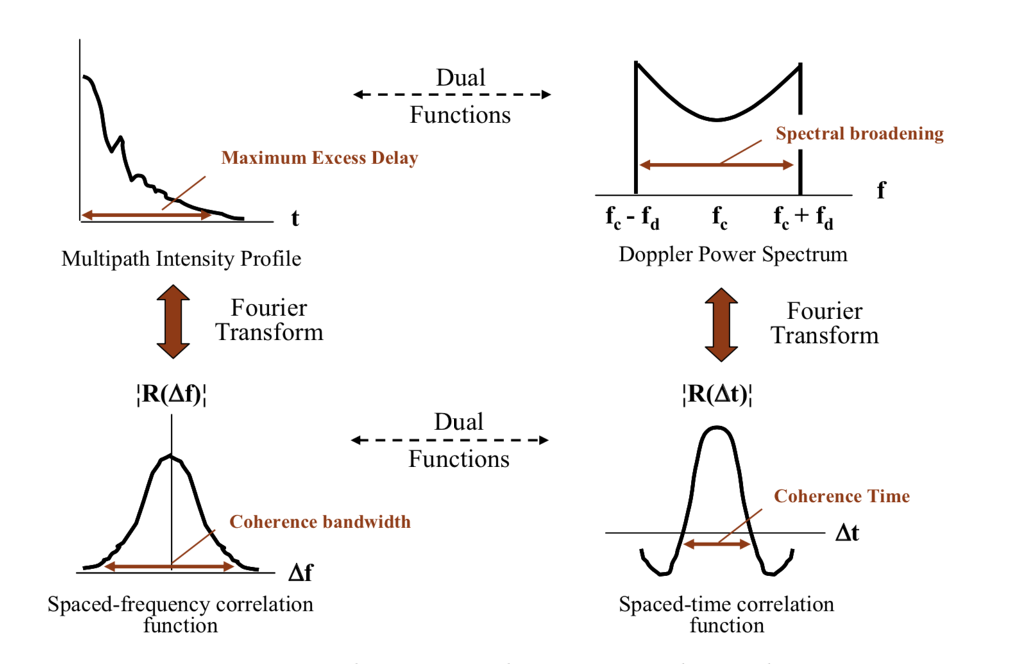
Spaced Frequency Correlation Function
The correlation of the fading envelope in the frequency domain is known as
Spaced-frequency correlation function
It is computed from the Fourier Transform of the Power Delay Profile (or multipath intensity profile)
It shows how the signal is spread in the frequency domain
It can be used to compute the Coherence Bandwidth

Slide 5
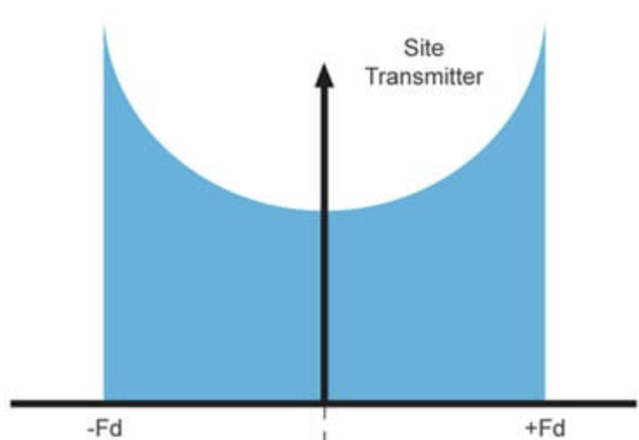

Doppler Spread & Power Doppler Spread
Doppler Spread is a measure of the spectral broadening caused by the time rate of change of the mobile radio channel, and is defined as the range of frequencies over which the received Doppler spectrum is essentially non-zero
Doppler frequency spread: Largest positive shift - largest negative shift
The Doppler Spread can be characterised by the Power Delay Spread
The Power Doppler Spread describes the output power of the multipath channel in frequency domain
As time spreading influences correlation in the frequency domain, frequency spreading influences correlation in the space/time domain
$$f_{c}$$

Slide 6
Spaced Time Correlation Function (1)
The correlation of the fading envelope in the space/time domain is often characterised by
Spaced-time correlation function
It is computed from the Fourier Transform of the Doppler Power Profile
It determines how rapidly the envelope fading varies as a function of spatial (or for a fixed velocity temporal) offset
It describes the correlation between different scattered signals received at two different times as a function of the difference in the received time

Slide 7
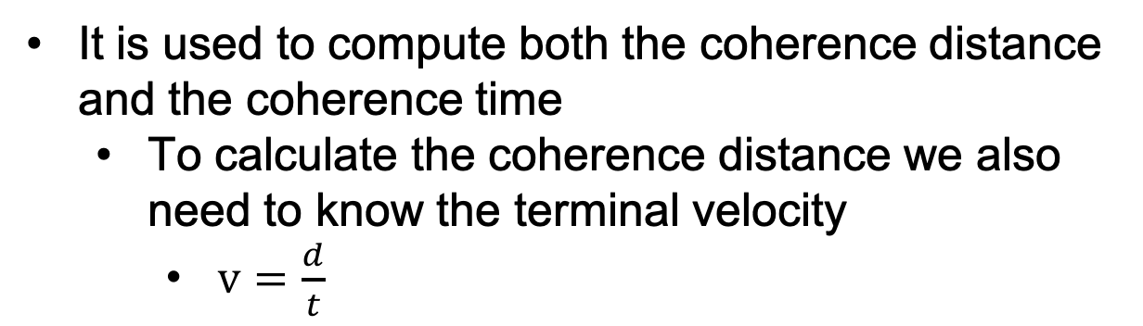
Spaced Time Correlation Function (2)
The spaced time correlation function is inversely related to the Doppler Spectrum
It is used to compute both the coherence distance and the coherence time
To calculate the coherence distance we also need to know the terminal velocity
$v=\frac{d}{t}$

Slide 8
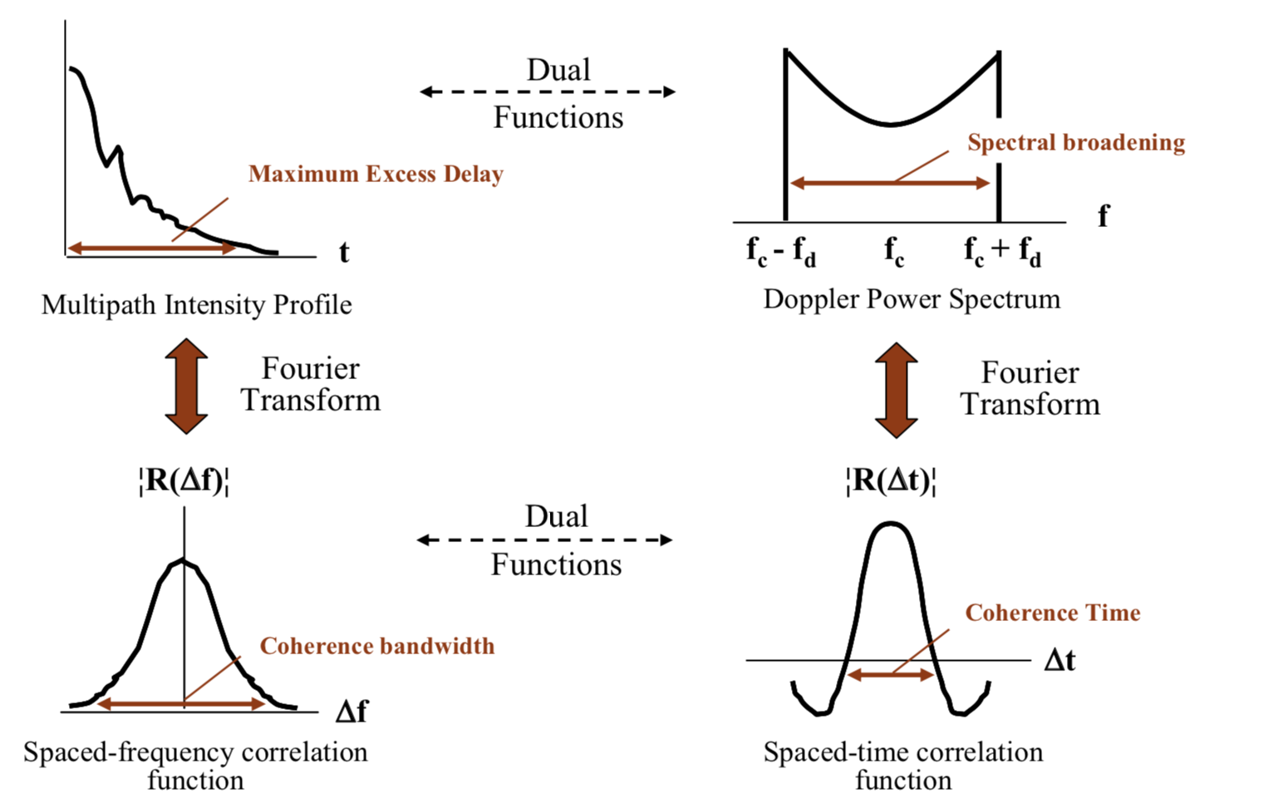
Correlation Properties of Fading Channel
Spaced Frequency Correlation Function
Spaced Time Correlation Function
Time spreading influences correlation in the frequency domain
Frequency spreading influences correlation in the space/time domain

Slide 9
Coherence bandwidth, time and distance
Coherence bandwidth
The frequency range over which the channel can be considered ‘flat’
Coherence time
Time duration over which the channel impulse response is considered to be not varying
Coherence distance
Spatial distance over which the channel does not change significantly
Coherence Time and Distance are inversely proportional to Doppler spread and Azimuth spread
Coherence Bandwidth is inversely proportional to delay spread

Slide 10
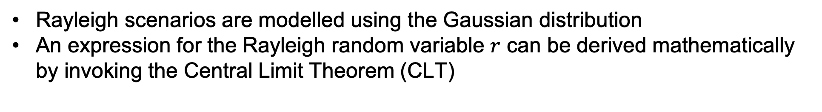
Central Limit Theorem
The Gaussian (Normal) distribution is a good model for the cumulate effect of a large number of independent and identically distributed random variables, regardless of the nature of their individual distributions
Rayleigh scenarios are modelled using the Gaussian distribution
An expression for the Rayleigh random variable $r$ can be derived mathematically by invoking the Central Limit Theorem (CLT)

Slide 11
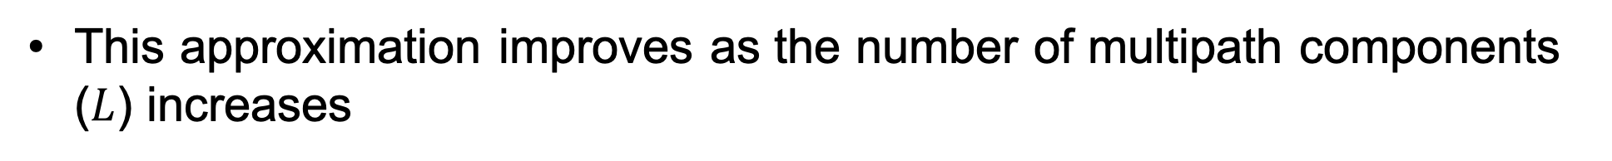
Derivation of Rayleigh Statistical Model using CLT (1)
Each multipath is a vector comprising of a magnitude and a phase
It can be decomposed to real and imaginary parts
Via the Central Limit Theorem, the cumulative sum of the real components, and the cumulative sum of the imaginary components, can be modelled using the Normal (Gaussian) distribution
This approximation improves as the number of multipath components ($L$) increases

Slide 12
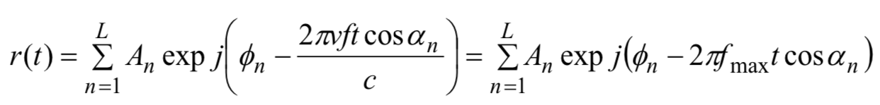
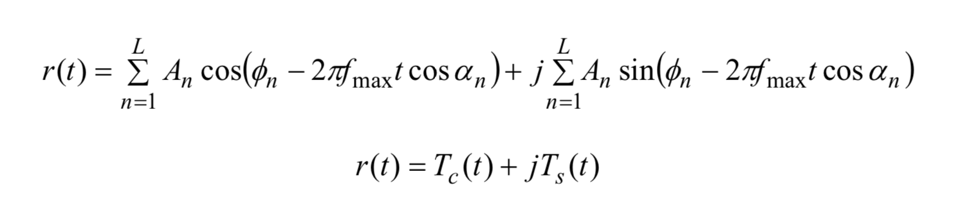

Decomposition of Multipaths
magnitude
phase
Each multipath is a vector comprising of a magnitude and a phase
It can be decomposed to real and imaginary parts
Real
Imaginary
magnitude
phase
magnitude
phase

Slide 13
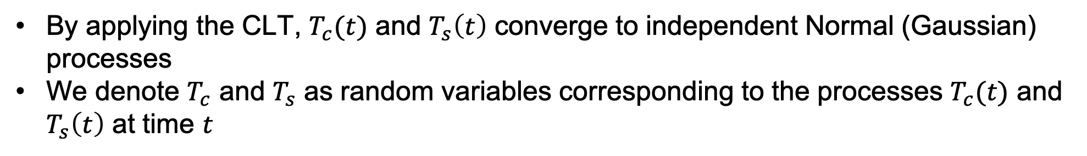


Derivation of Rayleigh Statistical Model using CLT (2)
$$T_{c}(t)$$
$$T_{s}(t)$$
We can write:
By applying the CLT, $T_{c}(t)$ and $T_{s}\left(t\right)$ converge to independent Normal (Gaussian) processes
We denote $T_{c}$ and $T_{s}$ as random variables corresponding to the processes $T_{c}(t)$ and $T_{s}\left(t\right)$ at time $t$

Slide 14
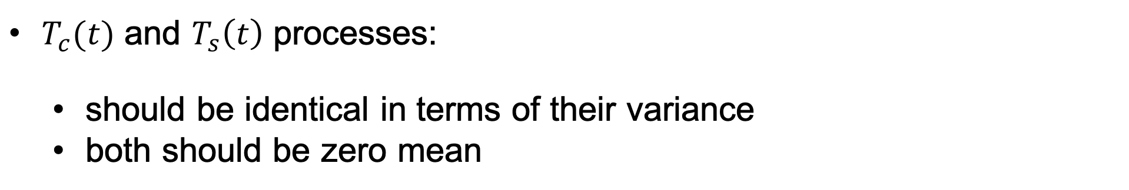
Derivation of Rayleigh Statistical Model using CLT (3)
Given the physical summation in
$T_{c}(t)$ and $T_{s}\left(t\right)$ processes:
should be identical in terms of their variance
both should be zero mean
For uniformly distributed $θ$ in the range 0-360 degrees:
$E\left\{\sum{cosθ}\right\}=E\left\{\sum{sinθ}\right\}=0$

Slide 15
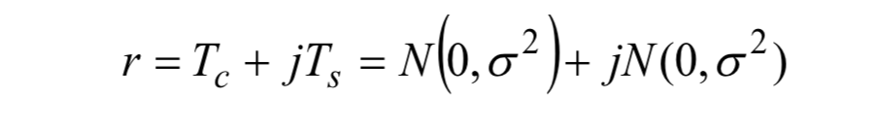
Derivation of Rayleigh Statistical Model using CLT (4)
Thus, a Rayleigh sample can be generated as:
Quadrature Normal (Gaussian) variance
where $N(mean,variance$)
The variance of a Normal (Gaussian) process is $σ^{2}$

Slide 16
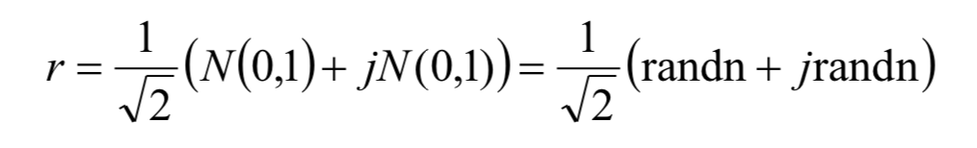
Normalised Rayleigh Samples
If we want to produce a number of power normalised rayleigh samples:
with variance $σ^{2}=1$
‘randn’: represents the Matlab command for a Normal random process with zero mean and unity variance

Slide 17
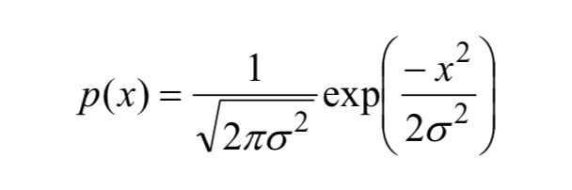
Probability Density
The Normal (Gaussian) samples have a probability density of:
Variance of quadrature Gaussian processes
Output random
variable

Slide 18
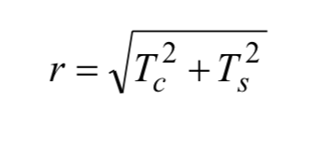
Received Signal Envelope
The received signal envelope is evaluated by:
By substituting probability density
into
We can express the probability density function (pdf)

Slide 19
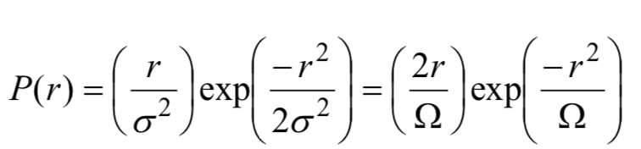


Rayleigh PDF
The Probability Density Function for $r$ can be expressed as:
with $r≥0$ and

Slide 20
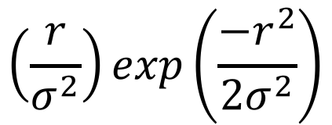
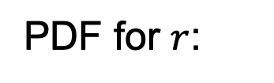

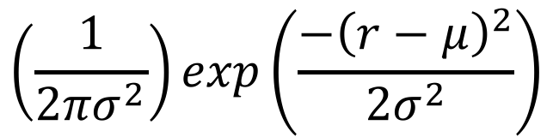
Rayleigh and Normal (Gaussian) PDFs (1)
PDF for $r$:
Rayleigh PDF
Normal PDF
$$\left(\frac{r}{σ^{2}}\right)exp\left(\frac{{−r}^{2}}{{2σ}^{2}}\right)$$
$$\left(\frac{1}{{2πσ}^{2}}\right)exp\left(\frac{{−\left(r−μ\right)}^{2}}{{2σ}^{2}}\right)$$
with $μ∈ℝ$ mean

Slide 21
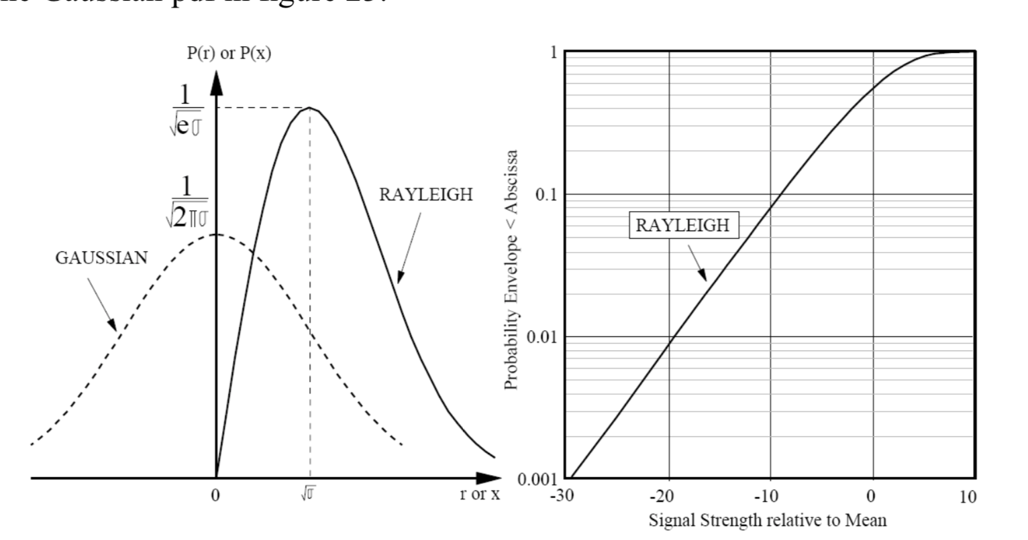
Rayleigh and Normal (Gaussian) PDFs (2)

Slide 22
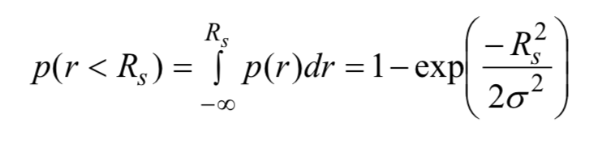
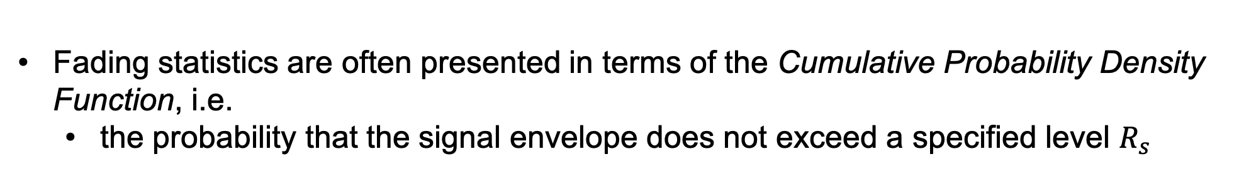
Rayleigh CDF (1)
Fading statistics are often presented in terms of the Cumulative Probability Density Function, i.e.
the probability that the signal envelope does not exceed a specified level $R_{s}$
The CDF for a Rayleigh process is given by:

Slide 23
Rayleigh CDF (2)
99.9% of time the signal envelope fluctuates with a dynamic range of around 40dB

Slide 24
Question 1
What is the probability of a Rayleigh envelope fading (relative to local mean) to be more than 10dB
Question 2
What is the probability of a Rayleigh envelope fading (relative to local mean) to be more than 20dB

Slide 25
Question 1
What is the probability of a Rayleigh envelope fading (relative to local mean) to be more than 10dB
Probability of received signal strength<-10dB from the mean
0.08
Around 0.08 or 8% of time

Slide 26
Question 2
What is the probability of a Rayleigh envelope fading (relative to local mean) to be more than 20dB
Probability of received signal strength<-20dB from the mean
0.009 or around 1% of time
0.009

Slide 27
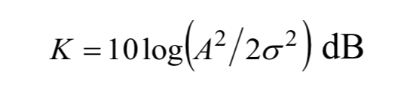
Rician Model
A Rician model is characterised by the existence of a dominant path
A path that arrives with greater amplitude compared to the remaining paths
It is characterised by the Rician K-factor:
envelope power of dominant path
envelope power of remaining components
The higher the K-factor, the less severe the fading

Slide 28
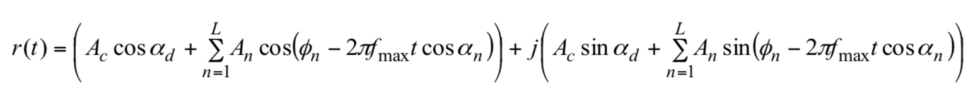
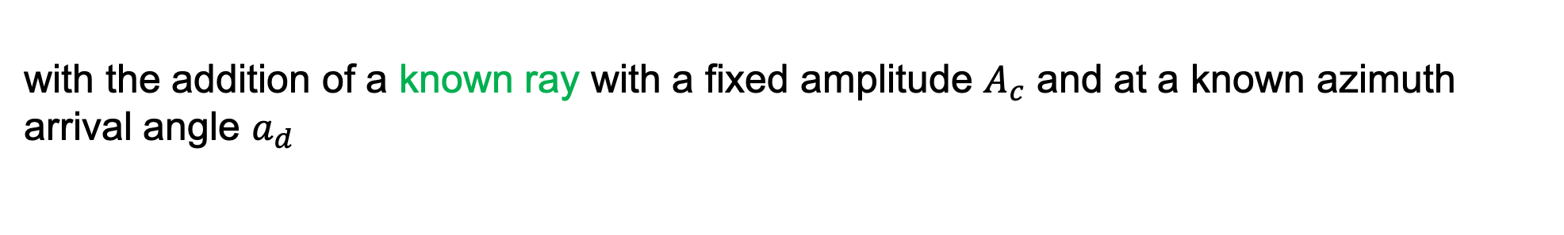
Rician Distribution (1)
Deterministic path is included:
dominant path
remaining multipaths
Equation is similar to the Rayleigh distribution:
with the addition of a known ray with a fixed amplitude $A_{c}$ and at a known azimuth arrival angle $a_{d}$

Slide 29
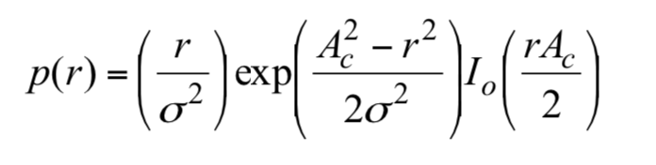
Rician Distribution (2)
Converting to polar coordinates and evaluating the appropriate integral, the Rician pdf is obtained:
envelope power of dominant path
modified Bessel function of order 0

Slide 30
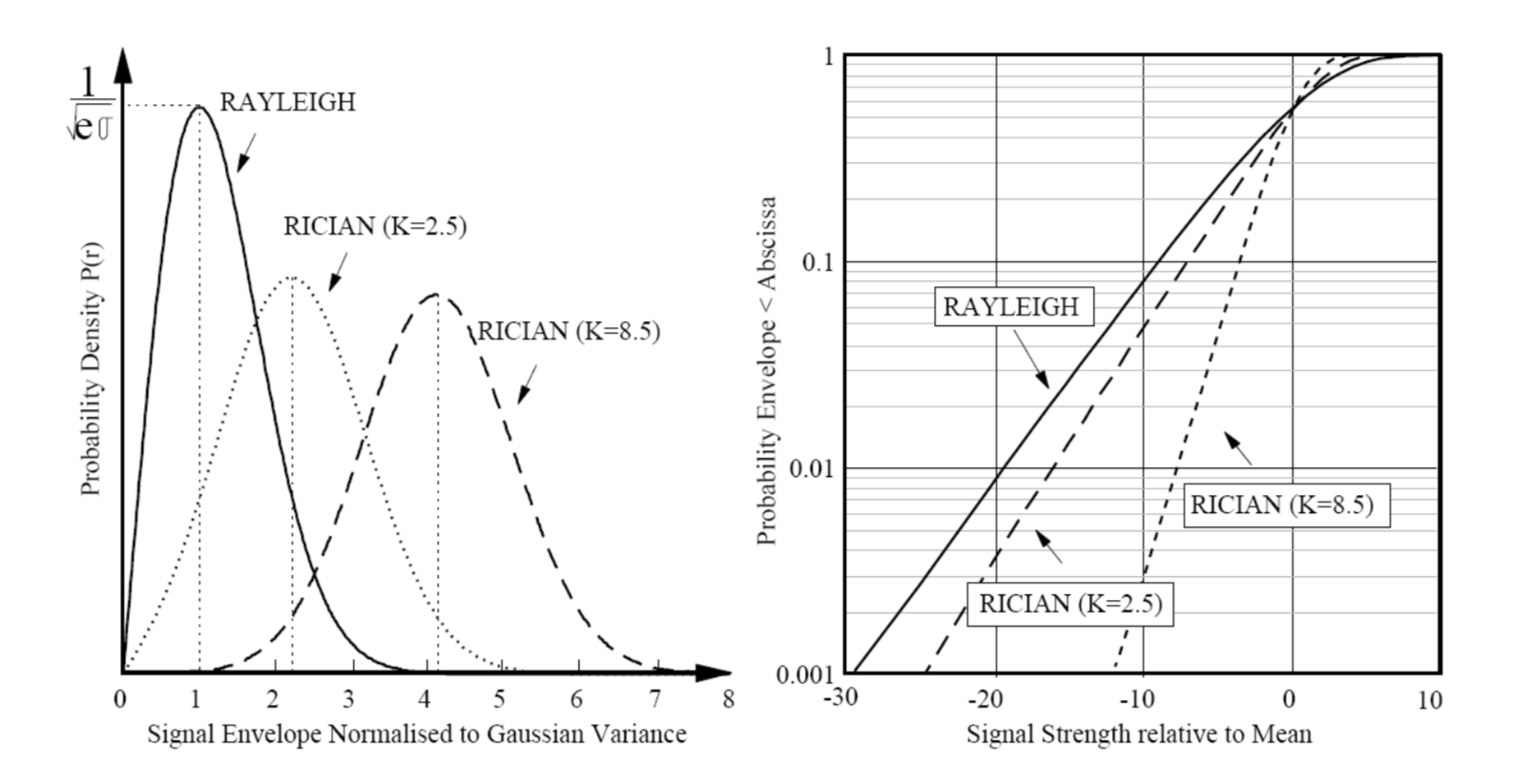
Rician PDF

Slide 31
Rician CDF
The CDF shows the more deterministic nature of the Rician channel
K=8.5dB: signal fluctuates for 99.9% of time within a dynamic range of just 24dB
Rayleigh: 40dB

Slide 32
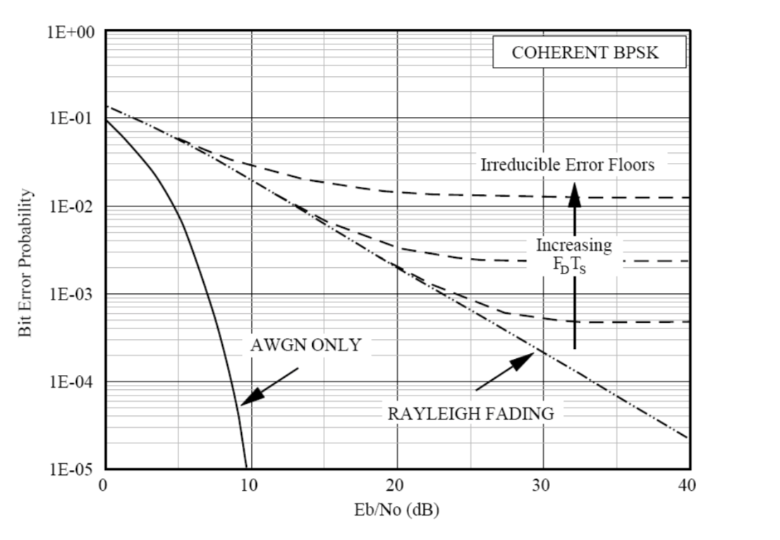
Channel Variations and effect on data transmission
Probability of error for coherent BPSK against Eb/No (energy per bit to noise power density)
Eb/No=SNR for BPSK
Because we have only one bit
Non-fading Additive White Gaussian Noise (AWGN)

Slide 33
Bit Error Rate (1)
For a fast fading channel, we need to compute the expected/average probability of bit error, incorporating fast fading statistics (fading pdf relative to the local mean)
Example:
Non-fading channel: If mean Eb/No=20dB, there will be no errors
Fast Fading channel: For a fast fade of 15dB relative to the local mean (x=-15dB), instantaneous Eb/No drops to 5dB, so errors will occur
Thus, the BER graph, in a Rayleigh channel, requires higher Eb/No values to reach error-free region
Fades of 30-40dB are possible in a Rayleigh channel, even at Eb/No=40dB, so it is possible that the signal drops, during instantaneous fades, into the noise floor

Slide 34
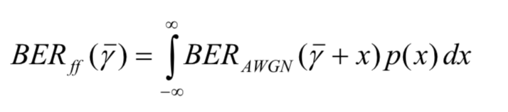
Bit Error Rate (2)
For a fast fading channel, we express the Bit Error Rate (BER):
Non-fading AWGN BER
Average Eb/No
Fast fading pdf
The equation cannot be used to find irreducible errors

Slide 35
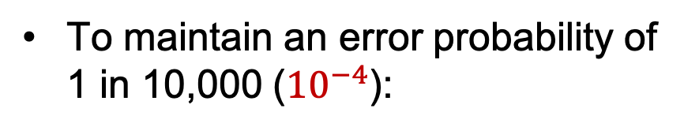
Bit Error Rate (2)
To maintain an error probability of 1 in 10,000 (${10}^{−4}$):
For an AWGN channel:
Eb/No should be greater than 8.5dB
For a Rayleigh channel:
Eb/No should be greater than 34dB

Slide 36
Error Floors
BER graphs assume coherent detection
Irreducible error floors = error floors that can be seen in BER graph sometimes
The error rate does not reduce as Eb/No (or SNR) increases

